Slide 1

Bidding on the Best
Naina Middela and Nethra Middela

Slide 2
Workflow
Background
Expected Hits Per Season
Bidding Process

Slide 3
Challenge
The Problem:
Maximize winning games
Predicting best players
The Goals:
Expected number of hits
Bidding on players

Slide 4
Expected Hits Per Season
Evaluating the Data
Condensed all seasons of 1 player by average value
Babe Ruth 35, 400, 26, 2014
Babe Ruth 36, 800, 27, 2015
Babe Ruth 37, 600, 26, 2016
Final:
Babe Ruth 36, 600, 26.3, —year—
2700 players —> avg stats of 543 players total

Slide 5
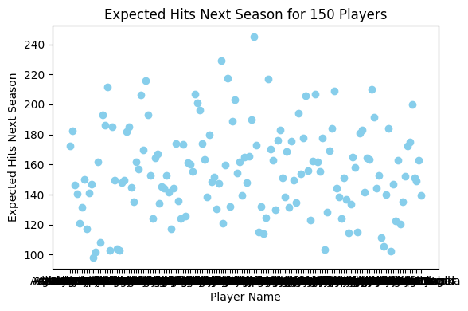
Expected Hits Per Season
Evaluating the Data
Found expected hits per season of 150 free agency players

Slide 6
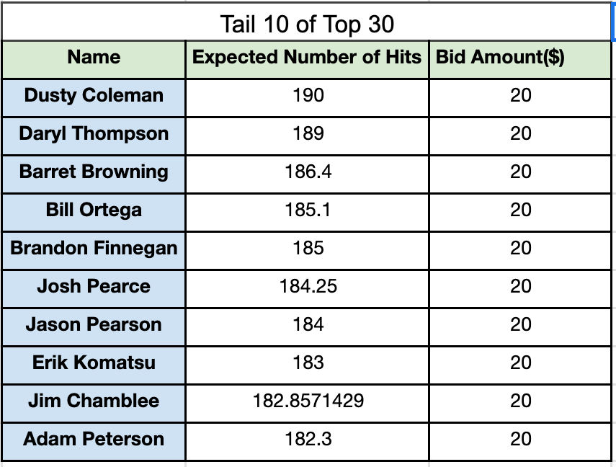
Bidding Amount
Found top 15% of players ~ regardless of position
Selected bottom 5% players
Bid $20 each to top 10%-15%
Found top 30 players
Bid $20 on last 10

Slide 7
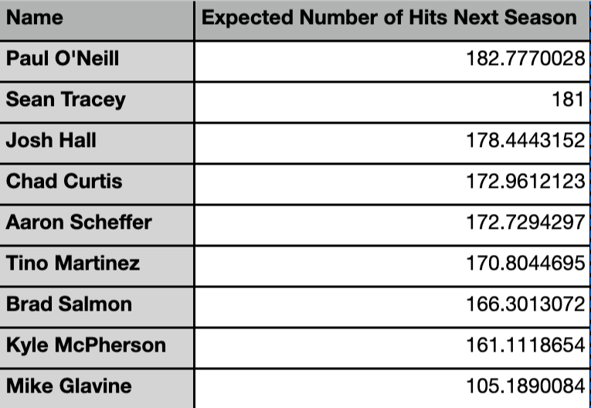
Replacing Players

Slide 8
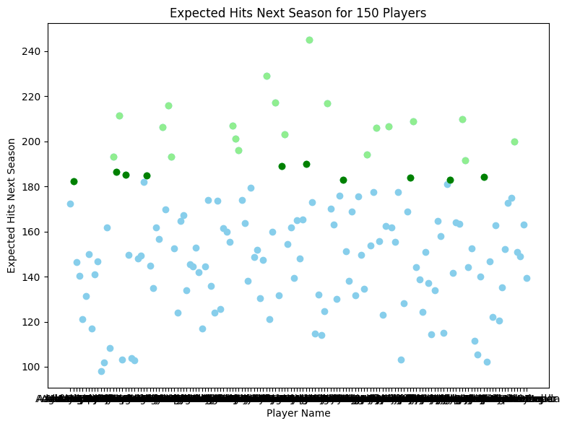
Selecting Free Agency Players

Slide 9
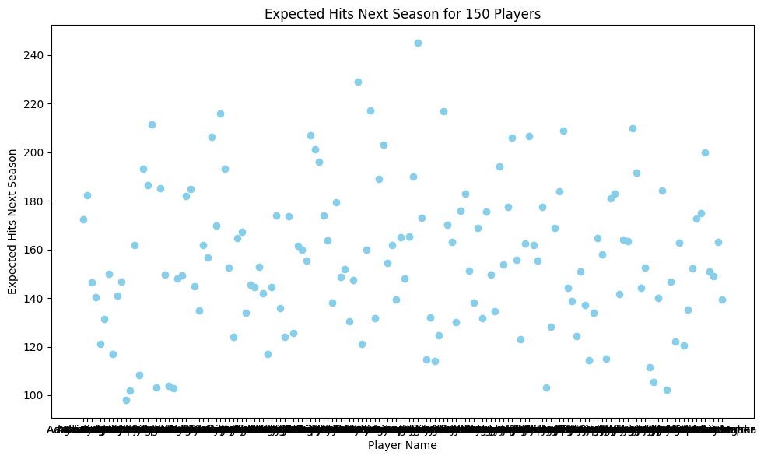
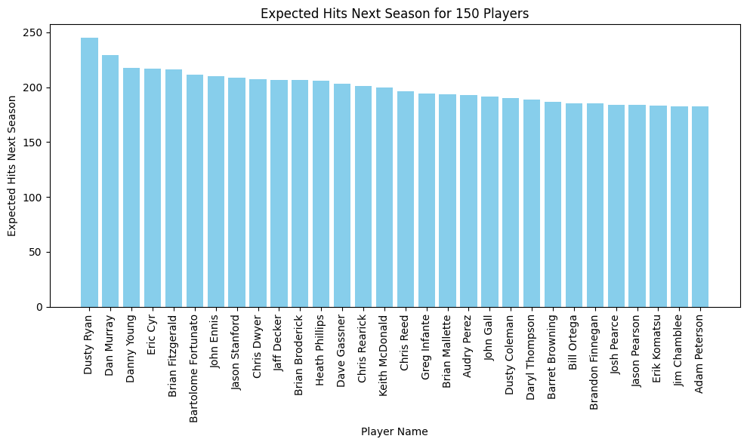
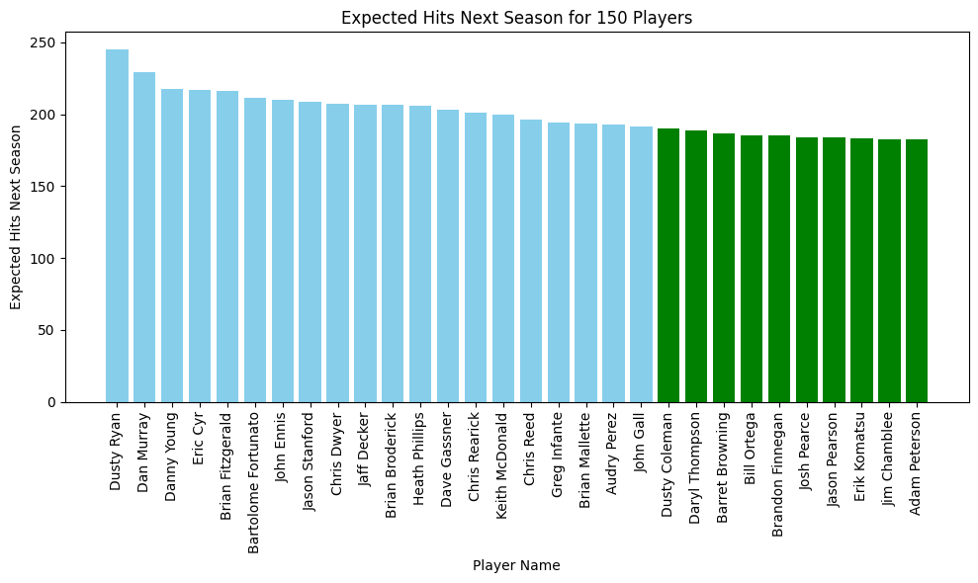
150 Players
Top 30 Players
Bottom 10 of Top 30,
Receiving $20 each

Slide 10
Conclusion
Other Factors
Position (pitcher, hitter, etc..)
Outstanding Players

Slide 11
Thank You

